Slide 1

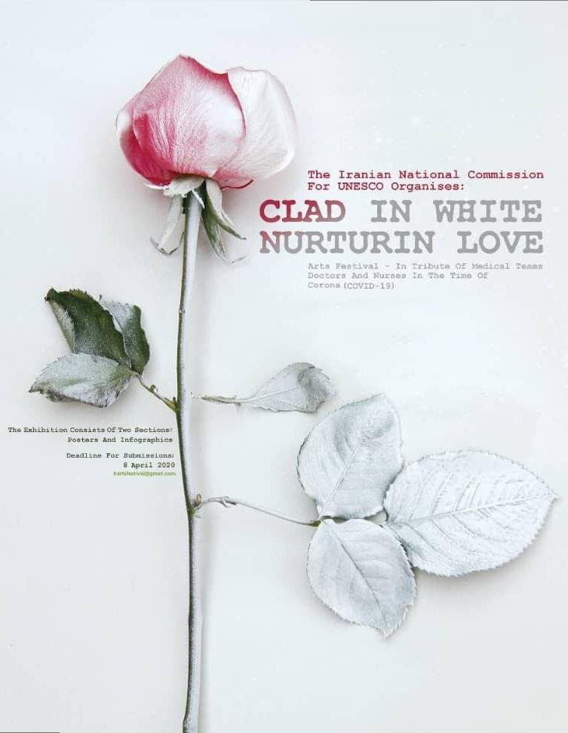
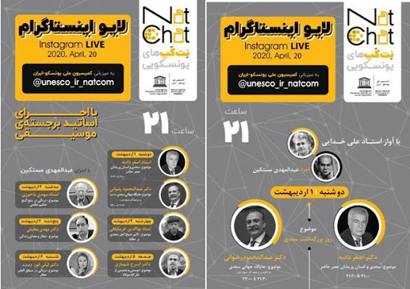
Home Music Festival with more than 230 clips from 1320 people and 30 nights live on Instagram with bests of Iran’s Arts

Slide 2
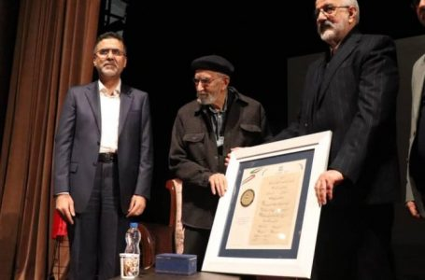
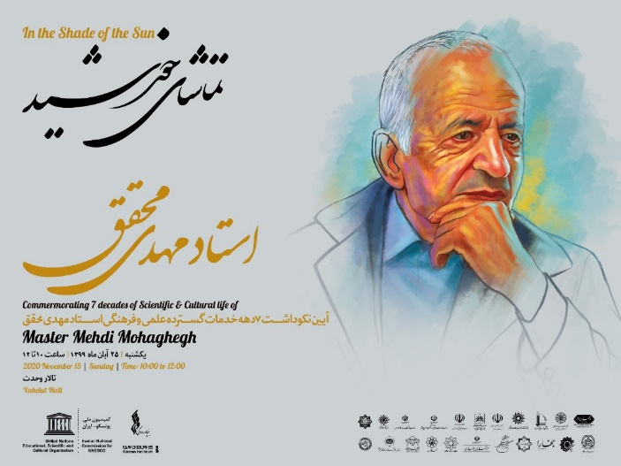
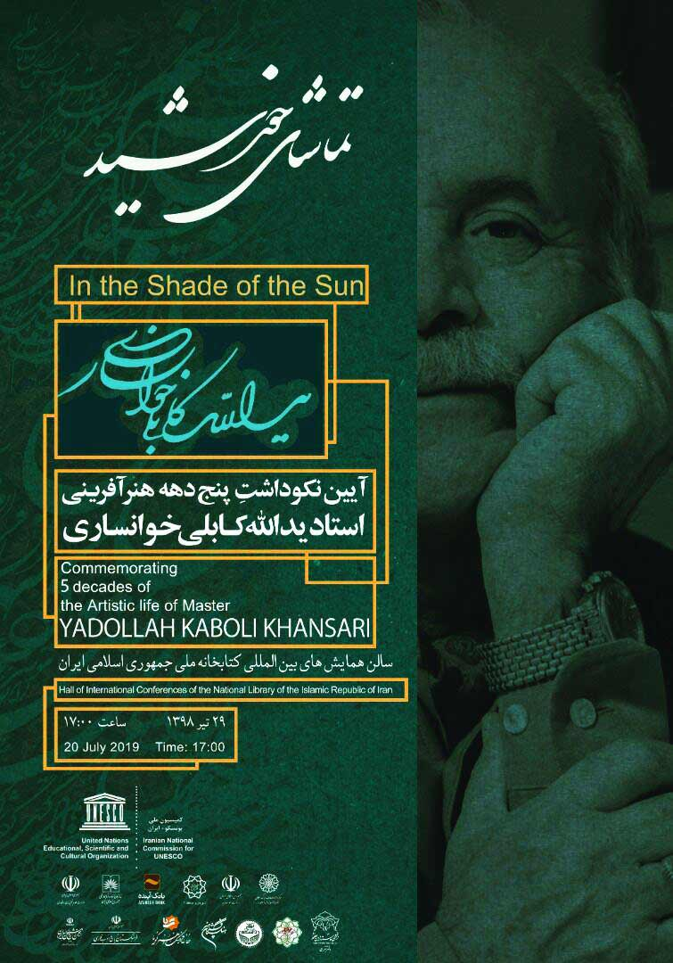
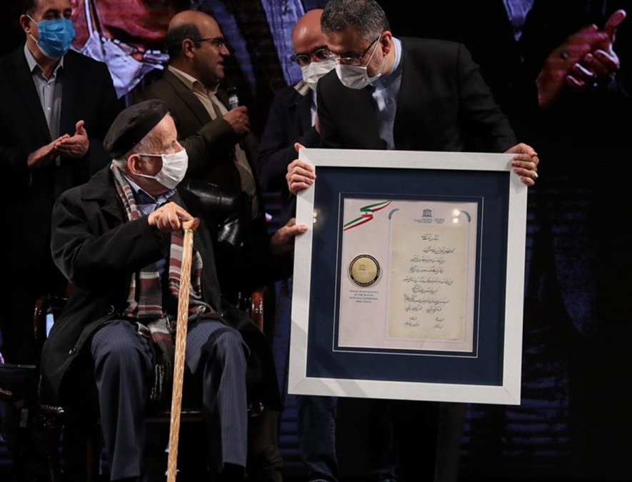
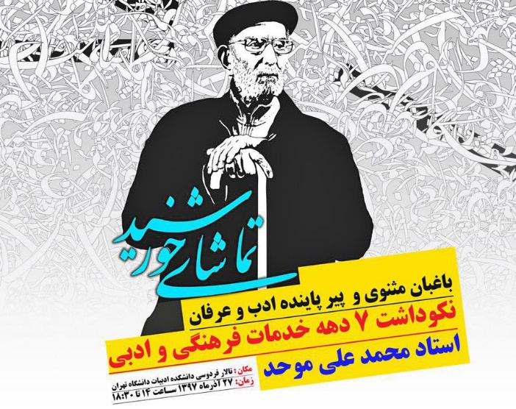
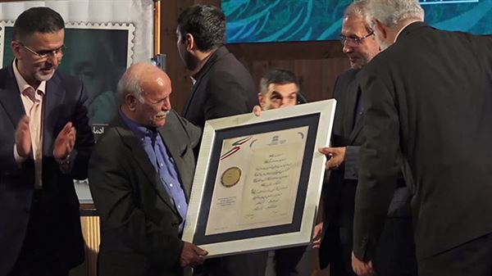
IN THE SHADE OF SUN
Iranian National Commission for UNESCO held a Commemoration ceremony for Professor Mohaghegh: unique figure of the world of literature and Islamic jurisprudence on 15 November 2020.
In this ceremony, Professor Mehdi Mohaghegh was awarded a Medal by the Iranian National Commission for UNESCO for his seven decades of scientific, cultural and Quranic activities and the stamp of Mehdi Mohaghegh was unveiled in the ceremony.
Professor Mohaghegh is a master in various fields, which is unique. He is not only an expert in contemporary research and the scope of his activities is very wide. In addition to his scientific activities, the special work he did was creation of structures for plans and work team.”

Slide 3
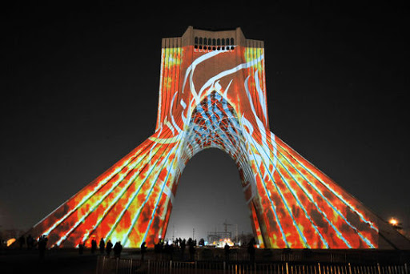
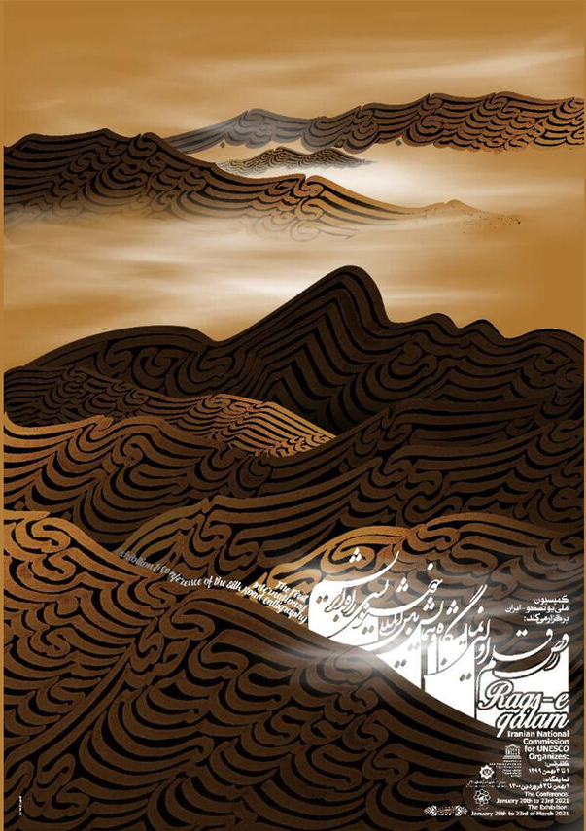
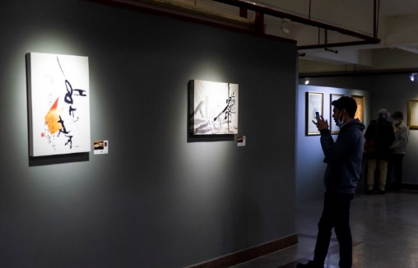
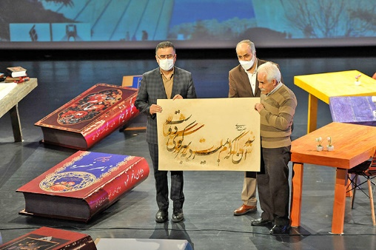
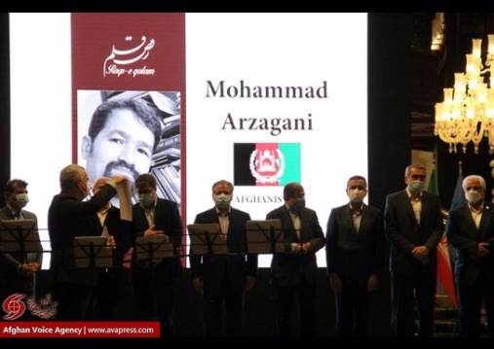
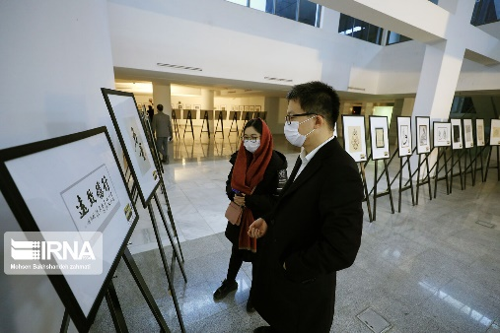
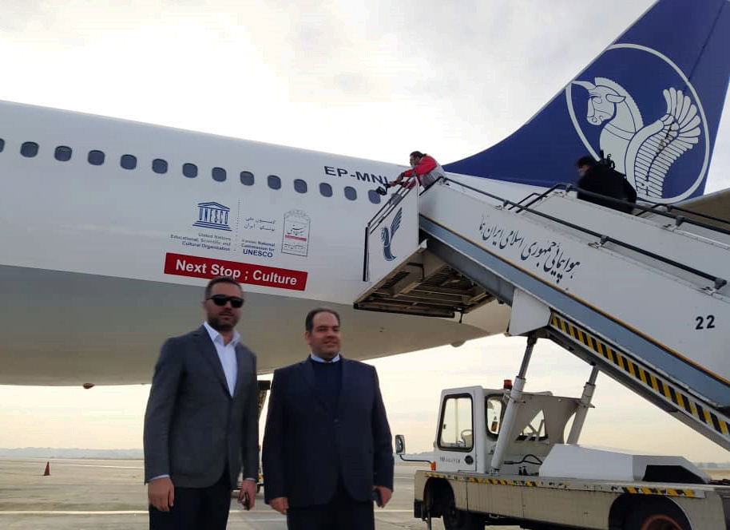
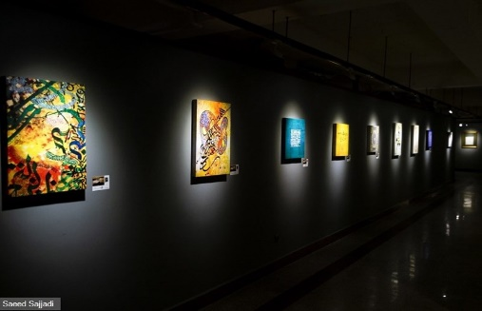
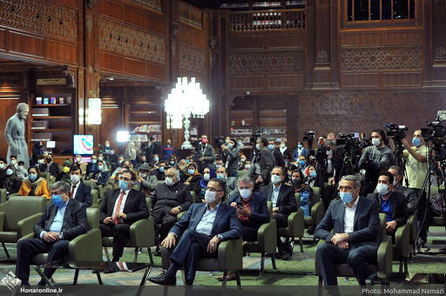
DANCING PEN
Contract with IRAN AIR TOUR Airline “Farokhball”
Opening ceremony in Mashhad City
Opening ceremony in Tehran
Video mapping, video art and light show in more than 20 cities
6 night virtual meeting with 40 calligraphy masters from all participant countries
Virtual gallery with more than 1000 artworks
Closing in Iran Mall

Slide 4
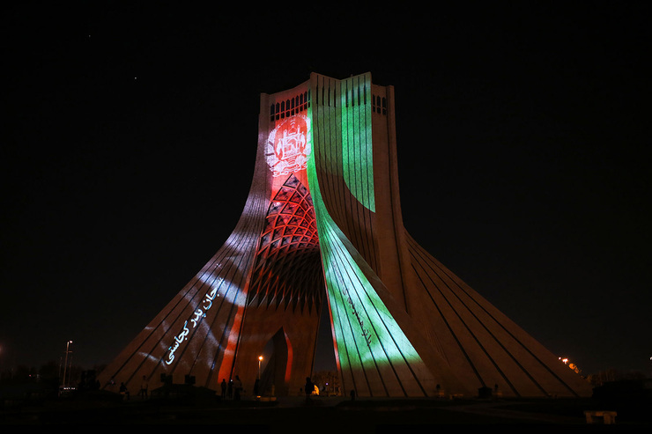
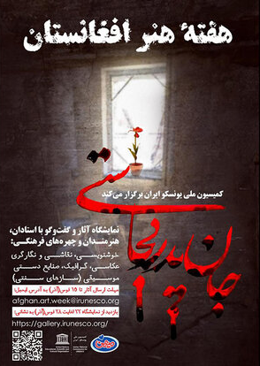
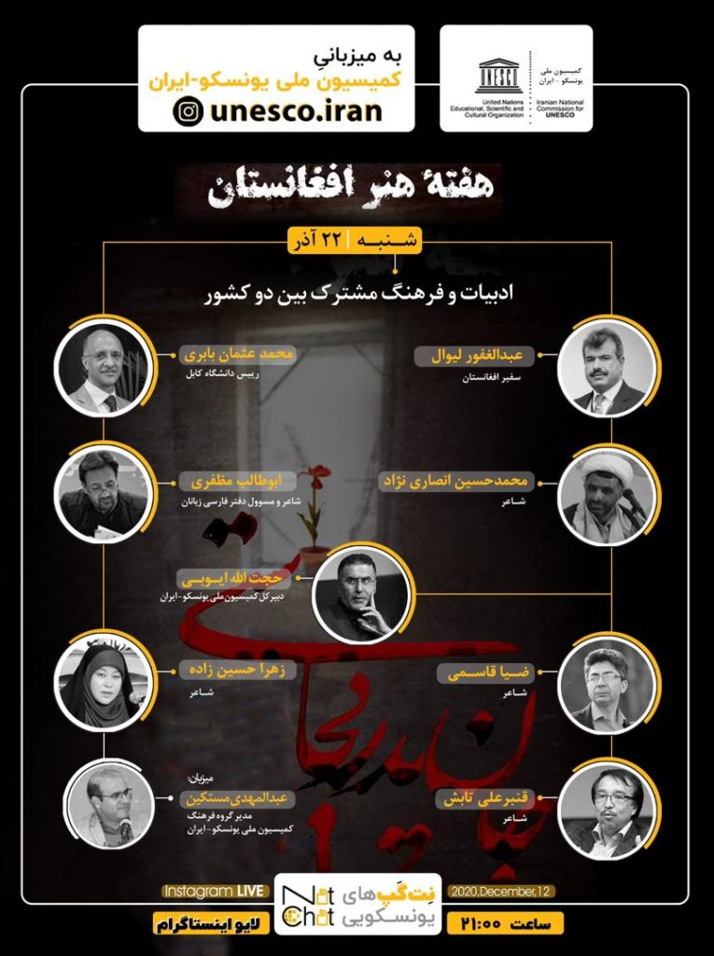
AFGANISTAN ART WEEK
Iranian National Commission for UNESCO – in commemoration of Afghanistan Art Week, entitled “Where are you father’s sweetheart”- organizes a virtual exhibition of works of art in the fields of calligraphy, painting, miniature, photography, graphics, handicrafts and music (traditional instruments), from 12 to 18 December 2020.
All the artists, who were interested in participating at this exhibition, submitted their scanned works, along with a resume including name and surname, year and place of birth, history of artistic activity to the secretariat of the exhibition.
The victims of the ISIS terrorist attack inspired the theme of the art exhibition. Several gunmen attacked Kabul University, shooting at students in their classrooms and clashing with security forces for hours.

